Slide 1
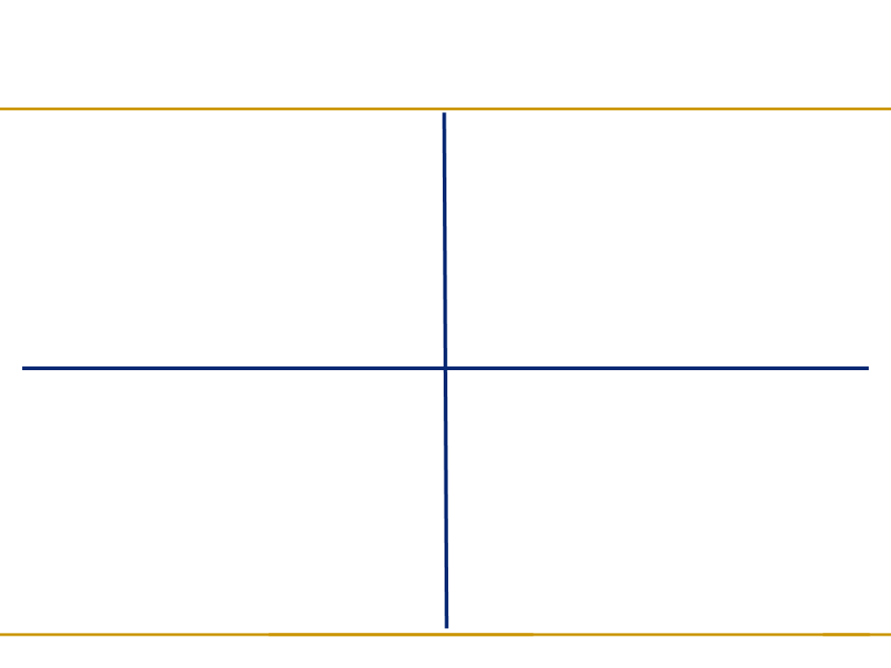
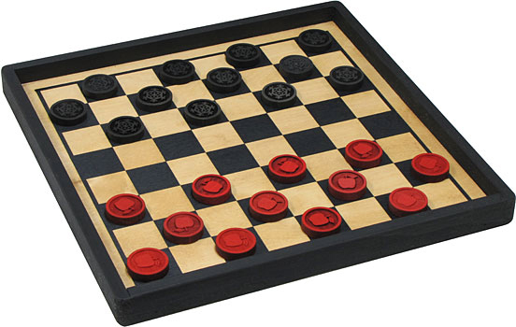
Project FlyingMoose
DESCRIPTION: An interactive checkers game will allow the user to hone their skills at checkers while trying to beat the computer or their friends
VALUE TO THE CUSTOMER:
  Can enjoy the game of checkers without having to manually reset the board and move pieces
  Can play checkers alone against the computer
  Hours of entertainment from one piece of software
OBJECTIVES
  Allow the user to play an accurate representation of the classic board game, checkers.
  Allow human or computer opponent.
  Provide aesthetically pleasing view of the board, simple controls, and intuitive gameplay mechanics.
  Immerse the user in a virtual reality that mimics an in-the-park experience of playing checkers with a stranger.
TECHNICAL APPROACH
  Program will be written and debugged in the Java Eclipse IDE
  Graphical user interface will be designed using Java's swing library

